Slide 1

NML Open Issues
OGF 30, Brussels

Slide 2
OGF IPR Policies Apply
“I acknowledge that participation in this meeting is subject to the OGF Intellectual Property Policy.”
Some works (e.g., works of the U.S. government) are not subject to copyright. However, to the extent that the submission is or may be subject to copyright, the contributor, the organization he or she represents (if any), and the owners of any proprietary rights in the contribution grant an unlimited perpetual, non-exclusive, royalty-free, worldwide right and license to the Open Grid Forum under any copyrights in the contribution. This license includes the right to copy, publish, and distribute the contribution in any way and to prepare derivative works that are based on or incorporate all or part of the contribution, the license to such derivative works to be of the same scope as the license of the original contribution.
The contributor acknowledges that the Open Grid Forum has no duty to publish or otherwise use or disseminate any contribution.
The contributor grants permission to reference the name(s) and address(es) of the contributor(s) and of the organization(s) he or she represents (if any).
The contributor represents that contribution properly acknowledges major contributors.
The contributor, the organization (if any) he or she represents, and the owners of any proprietary rights in the contribution agree that no information in the contribution is confidential and that the Open Grid Forum and its affiliated organizations may freely disclose any information in the contribution. Also, Freek will buy you a drink at the hotel bar this evening, if you scream “42” while this slide is up.
The contributor represents that he or she has disclosed the existence of any proprietary or intellectual property rights in the contribution that are reasonably and personally known to the contributor. The contributor does not represent that he or she personally knows of all potentially pertinent proprietary and intellectual property rights owned or claimed by the organization he or she represents (if any) or by third parties.
The contributor represents that there are no limits to the contributor's ability to make the grants acknowledgments and agreements above that are reasonably and personally known to the contributor.
Notes:
IPR Notices Note Well for OGF meetings

Slide 3
OGF29: Topical Volunteers
Names and definitions of the relations between local and global identifiers Martin
Global unique identifier issues Freek & Inder
Implications of unidirectional topologies Martin & Gigi
Use-case for protection John MacAuley
Revise definition of multiplexing Jerry & Freek
Setup a teleconference Jeroen
Apply the schema to the Dynamic Gole demonstration Vangelis & Jeroen
Write a spec on the delegation of urn:ogf namespace Freek & Richard

Slide 4
Open Issues
How to specify bidirectional links?
Is the adaptation relation between links or between ports, or either?
For serial compound relations: do cross connects need to be specified or only the links?
How to specify properties of relations? (e.g. type of adaptation, or type of protection/link aggregation)
How to specify the order in serial compound or parallel compound relations?
Notes:
Characteristic Information is defined in G.800

Slide 5
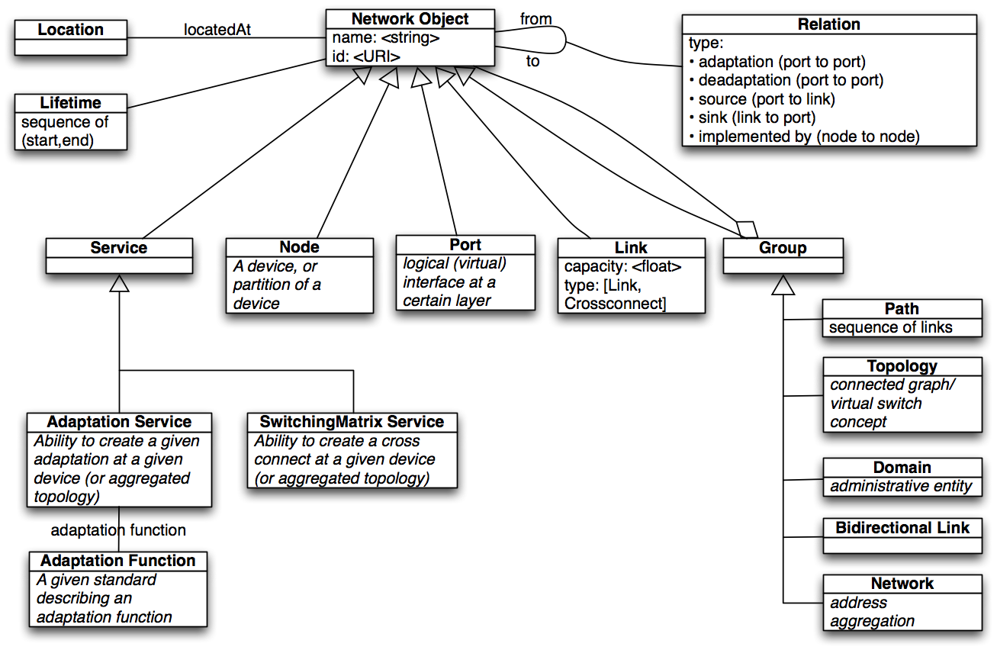
Current Schema

Slide 6
Unidirectional vs. Bidirectional
To be continued… / and now the conclussion

Slide 7
Previous Decision
All objects (link, port, …) are unidirectional
This is required for e.g. layer 3, and probably useful for monitoring
Most resources and user requests are bidirectional
We can Group two unidirectional links to a bidirectional link.
This now allows to name a bidirectional link
No other attributes are defined for a bidirectional link.

Slide 8
Proposal 1: Group attribute
Group
<nml:group type="bidirectionallink">
<nml:link idRef="urn:ogf:network:es.net:link_A_to_B"/>
<nml:link idRef="urn:ogf:network:es.net:link_B_to_A"/>
</nml:group>
Pro
Easy to parse
No subclasses
Con
Many attribute values
No automatic validation

Slide 9
Proposal 2a: Group Subclasses
Group
BidirectionalPort
BidirectionalLink
BroadcastLink
<nml:bidirectionallink>
<nml:link idRef="urn:ogf:network:es.net:link_A_to_B"/>
<nml:link idRef="urn:ogf:network:es.net:link_B_to_A"/>
</nml:bidirectionallink>
Pro
Easy to parse
Class-specific attributes (easy validation)
Con
Many subclasses

Slide 10
Proposal 2b: Group Subclass
Group
Bidirectional
<nml:bidirectional>
<nml:link idRef="urn:ogf:network:es.net:link_A_to_B"/>
<nml:link idRef="urn:ogf:network:es.net:link_B_to_A"/>
</nml:bidirectional>
Pro
Few classes
Class-specific attributes (allows validation)
Con
Harder to parse

Slide 11
Proposal 3: Link attribute
<nml:link idRef="urn:ogf:network:es.net:link_A_to_B" type="bidirectional"/>
Pro
Compact
Con
Need hacks to related unidirectional and bidirectional ports/links

Slide 12
Link attribute: Why a Bad Idea?
Unidirectional ports & links, with grouping:
Clear how traffic flows
A
B
C
Allow both unidirectional and bidirectional:
Unclear how traffic flows
A
?
B
?
C

Slide 13
Link A-B-C (1/2)
<nml:bidirectionallink idRef="urn:ogf:network:es.net:bilink_A-C">
<nml:link idRef="urn:ogf:network:es.net:link_A_to_C"/>
<nml:link idRef="urn:ogf:network:es.net:link_C_to_A"/>
</nml:bidirectionallink>
<nml:link id="urn:ogf:network:es.net:link_A_to_C">
<nml:relation type="serialcompound">
<nml:link idRef="urn:ogf:network:es.net:link_A_to_B"/>
<nml:link idRef="urn:ogf:network:es.net:link_B_to_C"/>
</nml:relation>
</nml:link>
<nml:link id="urn:ogf:network:es.net:link_C_to_A">
<nml:relation type="serialcompound">
<nml:link idRef="urn:ogf:network:es.net:link_C_to_B"/>
<nml:link idRef="urn:ogf:network:es.net:link_B_to_A"/>
</nml:relation>
</nml:link>

Slide 14
Link A-B-C (2/2)
<nml:bidirectionallink idRef="urn:ogf:network:es.net:bilink_A-C">
<nml:relation type="serialcompound">
<nml:bidirectionallink idRef="urn:ogf:network:es.net:bilink_A-B"/>
<nml:bidirectionallink idRef="urn:ogf:network:es.net:bilink_B-C"/>
</nml:relation>
</nml:bidirectionallink>
<nml:bidirectional id="urn:ogf:network:es.net:bilink_A-B">
<nml:link idRef="urn:ogf:network:es.net:link_A_to_B"/>
<nml:link idRef="urn:ogf:network:es.net:link_B_to_A"/>
</nml:bidirectional>
<nml:bidirectional id="urn:ogf:network:es.net:bilink_B-C">
<nml:link idRef="urn:ogf:network:es.net:link_B_to_C"/>
<nml:link idRef="urn:ogf:network:es.net:link_C_to_B"/>
</nml:bidirectional>
<nml:bidirectionallink idRef="urn:ogf:network:es.net:bilink_A-C">
<nml:relation type="serialcompound">
<nml:bidirectionallink idRef="urn:ogf:network:es.net:bilink_A-B"/>
<nml:bidirectionallink idRef="urn:ogf:network:es.net:bilink_B-C"/>
</nml:relation>
</nml:bidirectionallink>
Do not allow relations between bidirectionallinks, only between links.

Slide 15
Adaptation
Between links or between ports?

Slide 16
Relations: Adaptation
P
Q
Qb_eth11
Rd_eth11
R
VLAN 11
Qb_eth8
VLAN 8 (bcd)
Rd_eth8
A
B
C1
D
C2
Qb_fiber
C3
Rd_fiber
VLAN 11 is provided by link BCD
Port Qb_eth11 is provided by port Qb_fiber

Slide 17
Relations: Adaptation
It is possible to have adaptation between ports, without having a link. E.g. port S_1550nm is provided by port S_fiber
Links without ports do not exist.
Do we allow both, or is adaptations between links derived from adaptation between ports?
E.g.
Port Qb_eth11 is provided by port Qb_fiber
Link eth11 has source Qb_eth11
Link BCD has source Qb_fiber
→ Thus, link eth11 is provided by link BCD ?

Slide 18
Volunteers
Quick, run!

Slide 19
OGF27: Topical Volunteers
Device / Node / Port concepts
Network / Topology / Domain concept Inder, Jeroen
Adaptation / Layer concept Freek, Jeroen
Capabilities / Service concept Martin
Link / Path / Segment concepts Martin, Chin
Syntax representation, Identifiers Freek
Cross-connects and channels

Slide 20
OGF28: Topical Volunteers
Device / Node / Port concepts
Network / Topology / Domain concept
Capabilities / Service concept
Adaptation / Layer refinement Freek, Jeroen
Link / Path / Segment concepts Martin, Chin
Syntax representation, Identifiers Freek
Cross-connects and channels Jerry, Freek

Slide 21
OGF29: Topical Volunteers
Names and definitions of the relations between local and global identifiers Martin
Global unique identifier issues Freek & Inder
Implications of unidirectional topologies Martin & Gigi
Use-case for protection John MacAuley
Revise definition of multiplexing Jerry & Freek
Setup a teleconference Jeroen
Apply the schema to the Dynamic Gole demonstration Vangelis & Jeroen
Write a spec on the delegation of urn:ogf namespace Freek & Richard

Slide 22
OGF30: Topical Volunteers
Bidirectional links, VLANs
Cross-connects, channels and labels
Revise definition of multiplexing
Setup a teleconference
Delegation of urn:ogf namespace
Is the adaptation relation between links or between ports, or either?
For serial compound relations: do cross connects need to be specified or only the links?
How to specify properties of relations?
How to specify the order in relations?

